Slide 1
lines -Cohen-Sutherland Line Clipping polygons -Sutherland-Hodgeman Polygon Clipping
CST 304 -Computer Graphics & Image Processing Module - 4 Fundamentals of Digital Image Processing
Text:Rafael C. Gonzalez and Richard E. Woods, Digital Image Processing. Pearson, 4e, 2017
SYLLABUS
Introduction to Image Processing and applications.
Image as 2D data. Image representation in Gray scale, Binary and Colour images.
Fundamental steps in Image Processing. Components of image processing system. Coordinate conventions. Sampling and quantization. Spatial and Gray Level Resolution.
Basic relationship between pixels– Neighbourhood, Adjacency, Connectivity.
Fundamentals of spatial domain- Convolution operation.

Slide 2
IMAGE PROCESSING – Fundamentals
Image processing involves processing or altering an existing image in a desired manner.
Digital Image Processing - Two major tasks :
Improvement of pictorial information for human interpretation
Processing of image data for storage, transmission and representation for autonomous machine perception
Need(Purpose) of image processing:-
Since the digital image is “invisible” it must be prepared for viewing on one or more output device (laser printer, monitor, etc)
The digital image can be optimized for the application by enhancing or altering the appearance of structures within it (based on: body part, diagnostic task, viewing preferences, etc)
It might be possible to analyze the image in the computer and provide cues to the radiologists to help detect important/suspicious structures (e.g.:Computed Aided Diagnosis, CAD)

Slide 3
Image Processing Fields
Computer Graphics: Creation of images
Image Processing: Enhancement or other manipulation of the image
Computer Vision: Analysis of the image content
The continuum from image processing to computer vision can be broken up into low, mid and high-level processes
Low Level Process
Input: Image Output: Image Examples: Noise removal, image sharpening
Mid Level Process
Input: Image Output: Attributes Examples: Object recognition, segmentation
High Level Process
Input: Attributes Output: Understanding Examples: Scene understanding, autonomous navigation

Slide 4
Digital Image Processing Applications
1)Gamma Ray Imaging
Astronomical observations
Medical applications
2) X-ray Imaging
Medical diagnostics
Angiography
Computerized axial tomography (CT scan)
Industry applications
3) Ultraviolet Imaging
Lithography
Industrial inspection
microscopy
lasers
astronomical observations.

Slide 5
Digital Image Processing Applications
4) Imaging in the visible and Infrared band
light microscopy
astronomy
remote sensing
industry
law enforcement (biometrics)
5)Imaging in the Microwave Band
Radar —collect data over virtually any region at any time , regardless of weather or ambient lighting conditions
6) Imaging in the Radio Band
Medicine —magnetic resonance imaging (MRI)
Astronomy

Slide 6
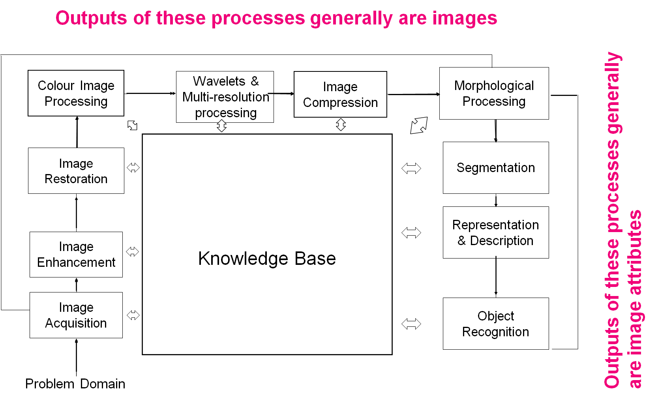
Fundamental Steps in Digital Image Processing
Notes:
Know base-everything related to image
Not all done together

Slide 7
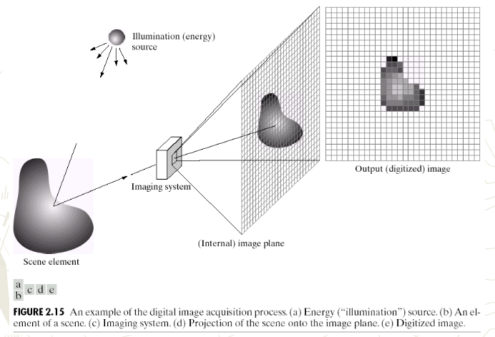
Fundamental Steps in Digital Image Processing
Step 1 : Image Acquisition
The image is captured by a sensor (eg. Camera), and digitized if the output of the camera or sensor is not already in digital form, using analog-to-digital convertor.

Slide 8
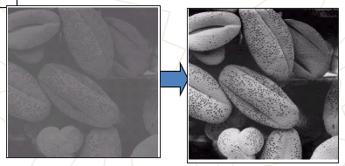
Fundamental Steps in Digital Image Processing
Step 2 : Image Enhancement
The process of manipulating an image so that the result is more suitable than the original for specific applications.
The idea behind enhancement techniques is to bring out details that are hidden, or simply to highlight certain features of interest in an image.

Slide 9
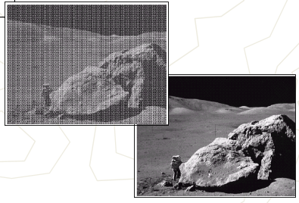
Fundamental Steps in Digital Image Processing
Step 3 : Image Restoration
Restoration - Improving the appearance of an image. Tend to be mathematical or probabilistic models. (objective procedure)
Enhancement, on the other hand, is based on human subjective preferences regarding what constitutes a “good” enhancement result.

Slide 10
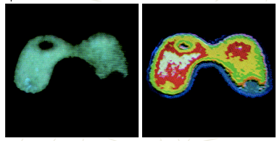
Fundamental Steps in Digital Image Processing
Step 4 : Colour Image Processing
Use the colour of the image to extract features of interest in an image
Restoration

Slide 11
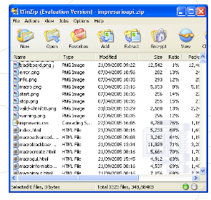
Fundamental Steps in Digital Image Processing
Step 5 : Wavelets(both frequency and time info are available)
Are the foundation of representing images in various degrees of resolution.
It is used for image data compression.
Step 6 : Compression
Techniques for reducing the storage required
to save an image or the bandwidth required
to transmit it.
Notes:
Wavelet-frequency and time information are available together

Slide 12
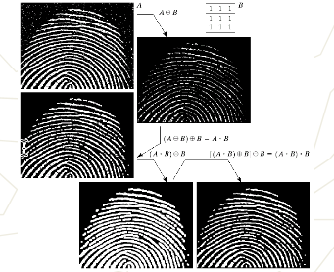
Fundamental Steps in Digital Image Processing
Step 7 : Morphological Processing
Tools for extracting image components that are useful in the representation and description of shape.
In this step, there would be a transition from processes that output images, to processes that output image attributes.
Notes:
2 basic operations
Erosion-unwanted bulging removal –made smooth
Dialation- boundary gap filling using near pixel intensity values

Slide 13
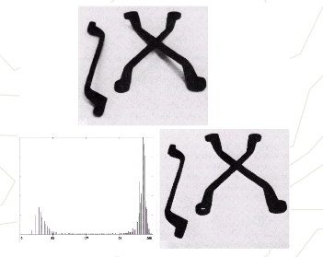
Fundamental Steps in Digital Image Processing
Step 8 : Image Segmentation
Segmentation procedures partition an image into its constituent parts or objects.

Slide 14
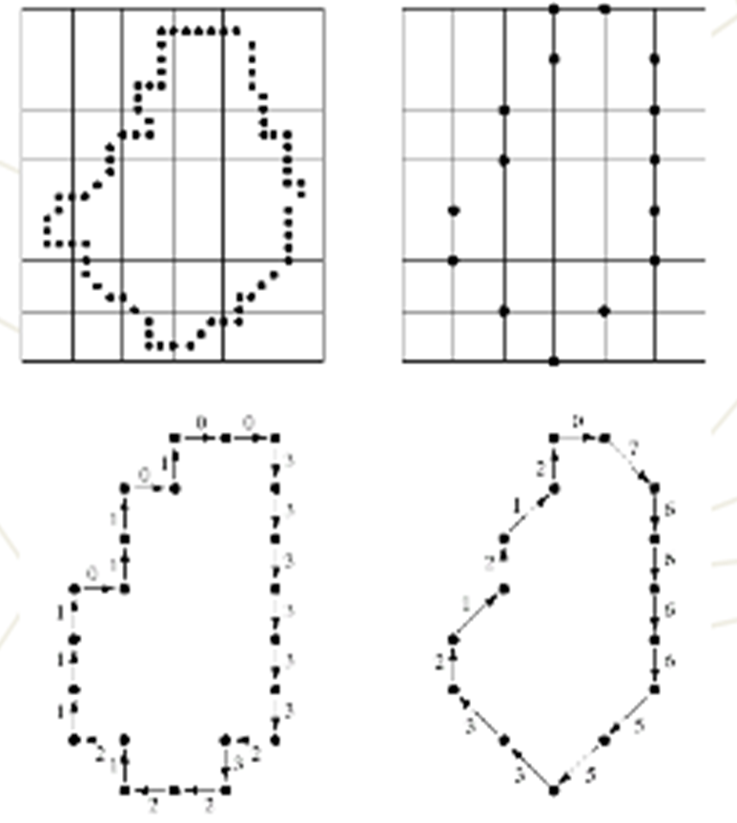
Fundamental Steps in Digital Image Processing
Step 9 : Representation and Description
Representation: Make a decision whether the data should be represented as a boundary or as a complete region. It almost always follows the output of a segmentation stage.
Boundary Representation: Focus on external shape characteristics, such as corners
Region Representation: Focus on internal properties, such as texture
Choosing a representation is only part of the solution for transforming raw data into a form suitable for subsequent computer processing (mainly recognition).
Description: also called, feature selection, deals with extracting attributes that result in some information of interest.

Slide 15
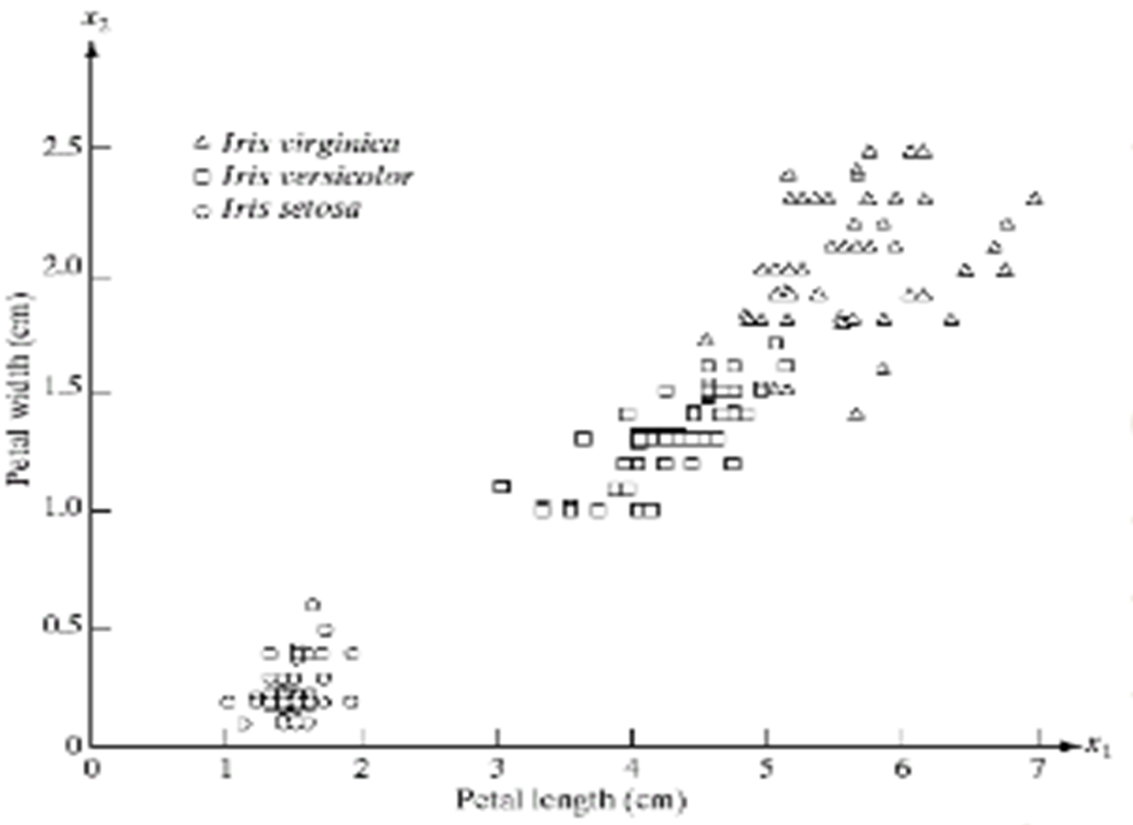
Fundamental Steps in Digital Image Processing
Step 10: Object Recognition
Recognition: the process that assigns label to an object based on the information provided by its description.
Step 11 : Knowledge Base
Knowledge about a problem domain is coded into an image processing system in the form of a knowledge database.

Slide 16
Components of an Image Processing System
Network
Image displays
Computer
Mass storage
Specialized image processing hardware
Image processing software
Hardcopy
Typical general-purpose DIP system
Image sensors
Problem Domain

Slide 17
Components of an Image Processing System
1. Image Sensors - Two elements are required to acquire digital images. The first is the physical device that is sensitive to the energy radiated by the object we wish to image (Sensor). The second, called a digitizer, is a device for converting the output of the physical sensing device into digital form.
2. Specialized Image Processing Hardware - Usually consists of the digitizer, mentioned before, plus hardware that performs other primitive operations, such as an arithmetic logic unit (ALU), which performs arithmetic and logical operations in parallel on entire images.
This type of hardware sometimes is called a front-end subsystem, and its most distinguishing characteristic is speed. In other words, this unit performs functions that require fast data throughputs that the typical main computer cannot handle.
3. Computer - The computer in an image processing system is a general-purpose computer and can range from a PC to a supercomputer. In dedicated applications, sometimes specially designed computers are used to achieve a required level of performance.

Slide 18
Components of an Image Processing System
4. Image Processing Software - Software for image processing consists of specialized modules that perform specific tasks. A well-designed package also includes the capability for the user to write code that, as a minimum, utilizes the specialized modules.
5. Mass Storage Capability - Mass storage capability is a must in a image processing applications. An image of size 1024 * 1024 pixels requires one megabyte of storage space if the image is not compressed.
Digital storage for image processing applications falls into three principal categories:
Short-term storage for use during processing
Online storage for relatively fast recall
Archival storage, characterized by infrequent access
One method of providing short-term storage is computer memory. Another is by specialized boards, called frame buffers, that store one or more images and can be accessed rapidly.
The on-line storage method, allows virtually instantaneous image zoom, as well as scroll (vertical shifts) and pan (horizontal shifts). On-line storage generally takes the form of magnetic disks and optical-media storage. The key factor of on-line storage is frequent access to the stored data.
Finally, archival storage is characterized by massive storage requirements but infrequent need for access.

Slide 19
Components of an Image Processing System
6. Image Displays
The displays in use today are mainly colour (preferably flat screen) TV monitors. Monitors are driven by the outputs of the image and graphics display cards that are an integral part of a computer system.
7. Hardcopy devices
Used for recording images, include laser printers, film cameras, heat-sensitive devices, inkjet units and digital units, such as optical and CD-Rom disks.
8. Networking
It is almost a default function in any computer system, in use today. Because of the large amount of data inherent in image processing applications the key consideration in image transmission is bandwidth.
In dedicated networks, this typically is not a problem, but communications with remote sites via the internet are not always as efficient.

Slide 20
DIGITAL IMAGE REPRESENTATION
An image can be defined as a two-dimensional function f(x,y)
x,y : Spatial coordinate
f(x,y) : the amplitude of any pair of coordinate x,y, which is called the intensity or gray level of the image at that point.
x,y and f, are all finite and discrete quantities.
An image can be defined by a two-dimensional array specifically arranged in rows and columns.
Digital Image is composed of a finite number of elements, each of which elements have a particular value at a particular location. These elements are referred to as picture elements, image elements, and pixels.
A Pixel is most widely used to denote the elements of a Digital Image.

Slide 21

DIGITAL IMAGE REPRESENTATION
Types of an image
BINARY IMAGE
The binary image as its name suggests, contain only two pixel elements i.e 0 & 1, where 0 refers to black and 1 refers to white.
This image is also known as Monochrome.
Binary images have a format of PBM ( Portable bit map )

Slide 22
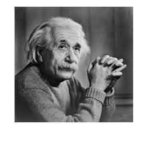
DIGITAL IMAGE REPRESENTATION
Types of an image
8 bit COLOR FORMAT(Gray Image)
It is the most famous image format.
It has 256 different shades of colors in it and commonly known as Grayscale Image.
In this format, 0 stands for Black, and 255 stands for white, and 127 stands for gray.
Format of these images are PGM( Portable Gray Map )
This format was used initially by early models of the operating systems UNIX and the early color Macintoshes.

Slide 23
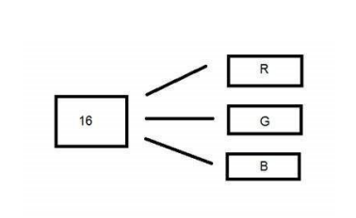
DIGITAL IMAGE REPRESENTATION
Types of an image
16 bit COLOR FORMAT
It is a color image format.
It has 65,536 different colors in it.
It is also known as High Color Format.
In this format the distribution of color is not as same as Grayscale image.
It is actually divided into three further formats which are Red, Green and Blue (RGB format).
It is pictorially represented in the image below.

Slide 24
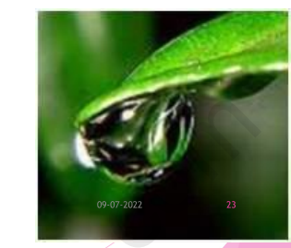
DIGITAL IMAGE REPRESENTATION
Types of an image
How would you distribute 16 into three. If you do it like this,
5 bits for R, 5 bits for G, 5 bits for B
Then there is one bit remains in the end.
So the distribution of 16 bit has been done like this.
5 bits for R, 6 bits for G, 5 bits for B.
The additional bit that was left behind is added into the green bit.
Because green is the color which is most soothing to eyes in all of these three colors.
This distribution is not followed by all the systems.

Slide 25
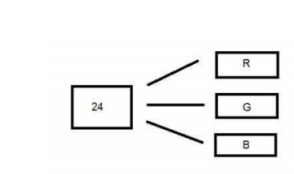
DIGITAL IMAGE REPRESENTATION
Types of an image
24 bit COLOR FORMAT
24 bit color format also known as true color format.
In a 24 bit color format, the 24 bits are distributed in three different formats of Red, Green and Blue
Since 24 is equally divided on 8, so it has been distributed equally between three different color channels.
Their distribution is like this.
8 bits for R, 8 bits for G, 8 bits for B.
Format
It is the most common used format. Its format is PPM ( Portable pixMap) which is supported by Linux operating system.
Windows has its own format for it which is BMP ( Bitmap)

Slide 26
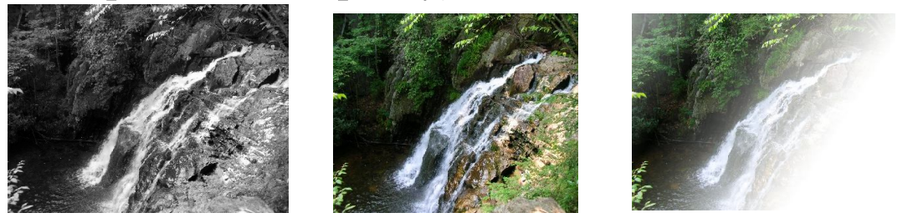
Common image formats
Common image formats include:
1 sample per point ( B&W or Grayscale)
3 samples per point ( Red, Green, and Blue)
4 samples per point ( Red, Green, Blue, and “Alpha”- Opacity)
(Opacity describes the degree to which an object or material is not transmitting light .)
Notes:
Opacity describes the degree to which an object or material is not transmitting light
The lower the opacity or the more light that can pass through an object
the lighter and more see-through it is. The higher the opacity or the less light that can pass through said object the more solid it is.

